Slide 1
Biodiversity project
Biodiversity analyst working for the National Parks Service.
Goal is to analyze some data about species at various national parks.

Slide 2
Provided information
species_info.csv
Data file contains name of species, conservation status, and protection status.
Notable features
Large percentage of species has no conservation status. Assume these are species that are not at risk of being endangered, and have had no intervention to date.
5541 total species: Mammals, Birds, Reptiles, Amphibian, Fish, Vascular Plant, Nonvascular Plant.
Conservation statuses: Not specified, Species of Concern, Endangered, Threatened, In Recovery

Slide 3
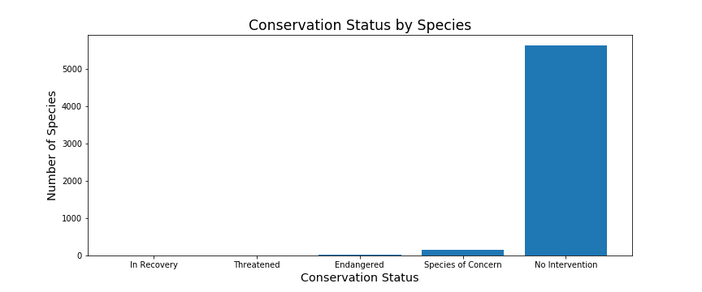
After identifying the blank conservation statuses as ‘No Intervention’ we plotted the relative frequencies of each conservation status, for all species.
This plot raises the question: which species are more likely to be endangered?
If we can identify these ‘at risk’ species, the appropriate intervention can be taken.

Slide 4
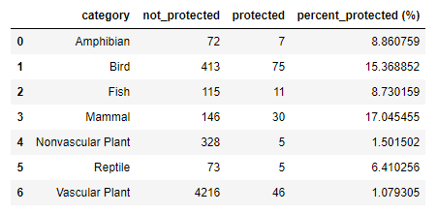
Statistical analysis
The species were separated into groups of ‘Protected’ and ‘Not-Protected’ and the counts are displayed in the following table.
Mammals and birds stand out as being the most protected. Are mammals more likely to be endangered than birds?
We employed a Chi Square test to answer this question. The results of a Chi Square test indicate if there is a significant difference between the two species.
Test results for Mammals and birds indicated no significant differences between the species, in terms of if one was more likely to be endangered or not (p value = 0.69).
Test was rerun for Reptiles and Mammals. Result (p value = 0.038) indicates significant difference.

Slide 5
Interpreting the results
Our statistical analysis indicated that Mammals are more at risk of being endangered than reptiles.
Where we go from here is up to the National Parks.
Option 1: Allocate more resources to the protection of mammals than to reptiles.
Option 2: Verify that the conservation statuses in the provided file are valid. This would require further statistical analysis. A starting point would be to obtain historical data of the number of species each year. Analyzing the change in the numbers of a species over time would shed insight into the true stability of their respective populations.
Option 3: Provide financial data, to verify that the available resources are being allocated in a manner consistent with the findings here.

Slide 6
Describe sample size determination that I did for the foot and mouth disease study

